Slide 1




Measuring Optical Constants for Semi-Heavy Water
By: Ryan Wochner
Mentors: Stephen Tegler and Will Grundy

Slide 2
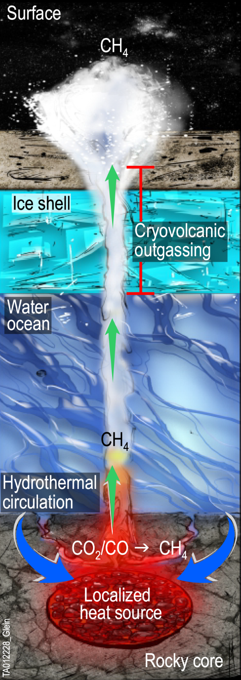
Background
Icy dwarf planets could have frozen interiors from center to surface.
Icy dwarf planets could also have liquid ocean interiors.
Determining the D/H ratio can help find the answer.
Glein et al., 2024

Slide 3
Timeline
Hapke
Models
Optical Constants of HDO
Synthetic Spectra of Icy Dwarf
JWST Spectra of Icy Dwarf
Geochemical Model
Comparison
Internal Oceans or not?
D/H Ratio

Slide 4
Timeline
Hapke
Models
Optical Constants of HDO
Synthetic Spectra of Icy Dwarf
JWST Spectra of Icy Dwarf
Geochemical Model
Comparison
Internal Oceans or not?
D/H Ratio

Slide 5
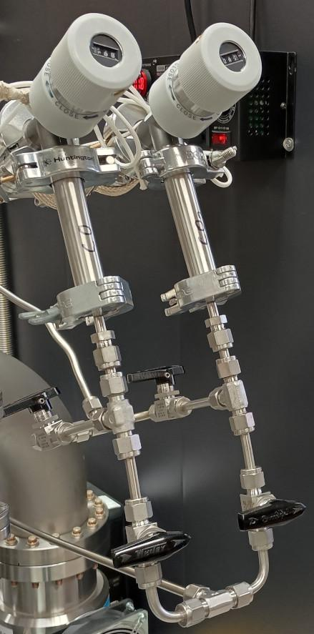
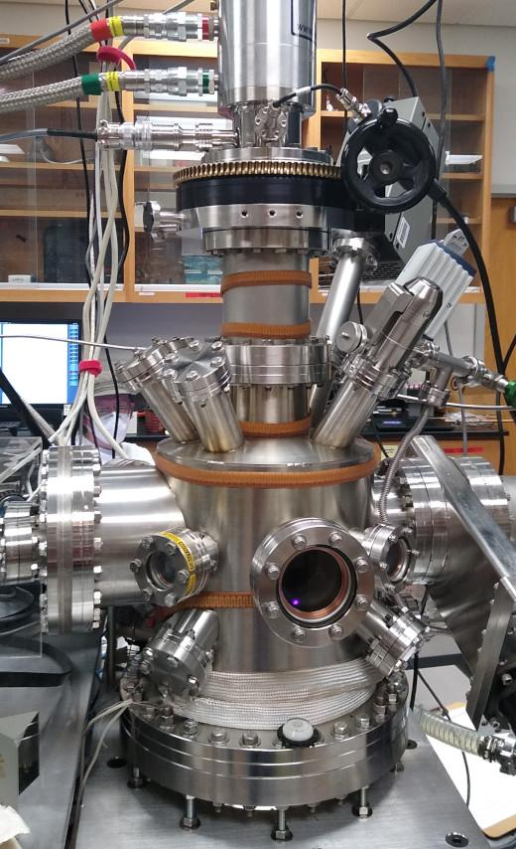
Experimental Setup
Equipment:
Helium refrigerator
  10 K - 150 K
Ultra-high vacuum
  10⁻⁹ torr, 1 trillion times more rarified than the air we breathe.
Infrared and ultraviolet-visible spectrometers
Procedure:
Started the experiment at 150 K then cooled to 10 K by 10 K increments.
Take IR and UV-Vis spectra of the sample.
  Use IR spectra to observe the “fingerprint” of HDO

Slide 6
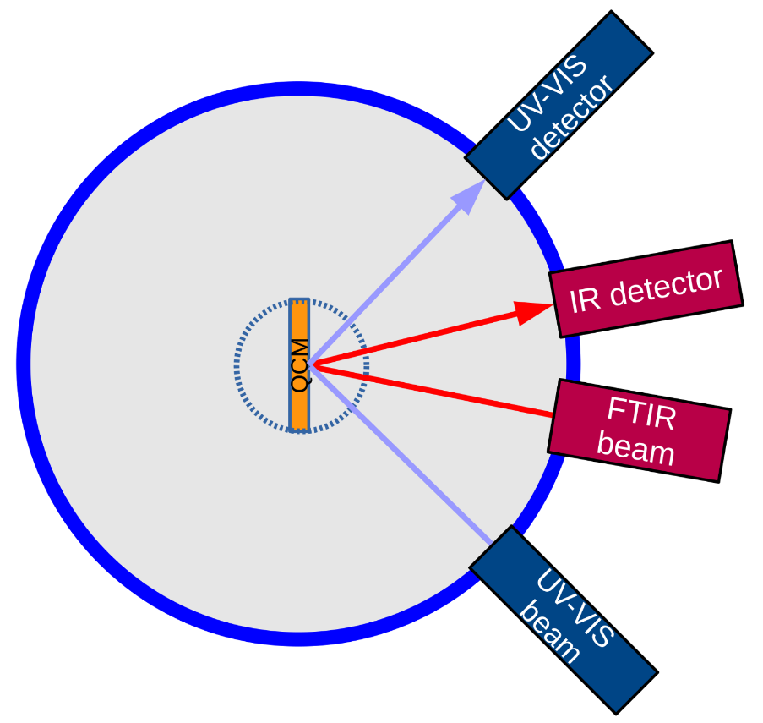
Experimental Setup
Equipment:
Helium refrigerator
  10 K - 150 K
Ultra-high vacuum
  10⁻⁹ torr, 1 trillion times more rarified than the air we breathe.
Infrared and ultraviolet-visible spectrometers
Procedure:
Started the experiment at 150 K then cooled to 10 K by 10 K increments.
Take IR and UV-Vis spectra of the sample.
  Use IR spectra to observe the “fingerprint” of HDO

Slide 7
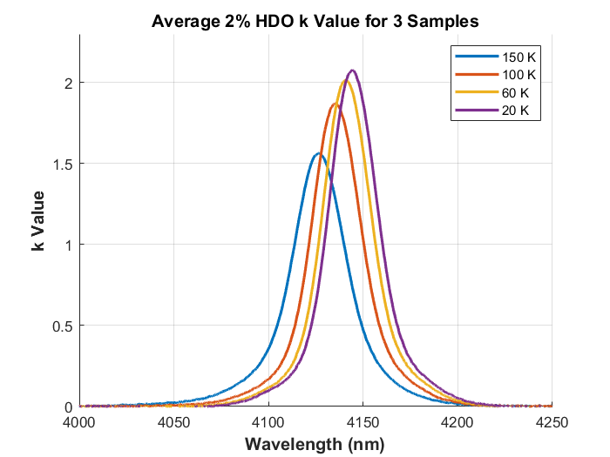
Results
We measured the imaginary component of optical constants for semi-heavy water.
An unexpected discovery was made: the values strongly depend on temperature.
  Can be used as a temperature probe for outer solar system objects.

Slide 8
Timeline
Hapke
Models
Optical Constants of HDO
Synthetic Spectra of Icy Dwarf
JWST Spectra of Icy Dwarf
Geochemical Model
Comparison
Internal Oceans or not?
D/H Ratio

